Slide 1
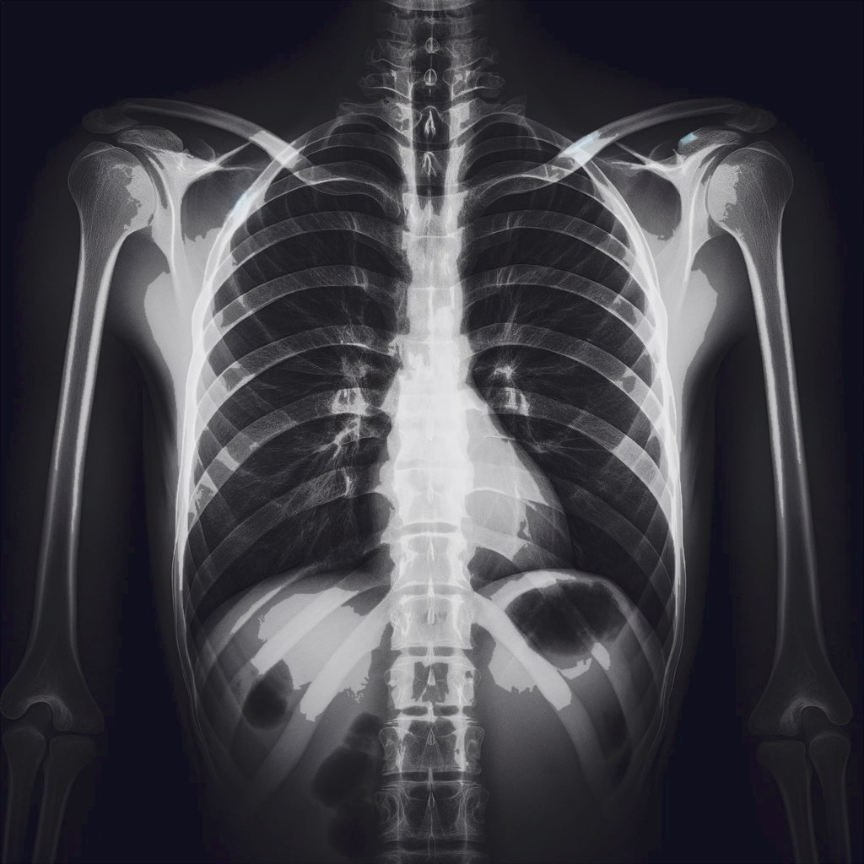
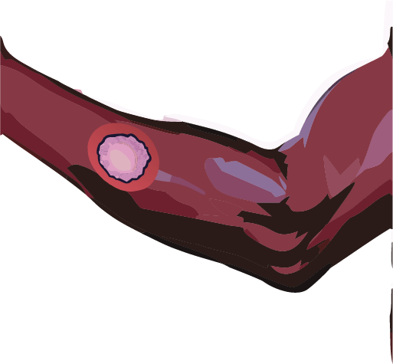

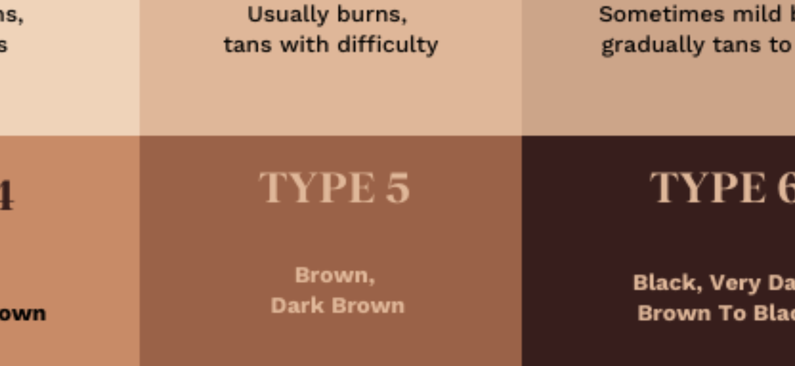
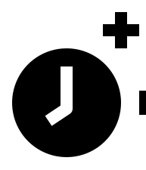


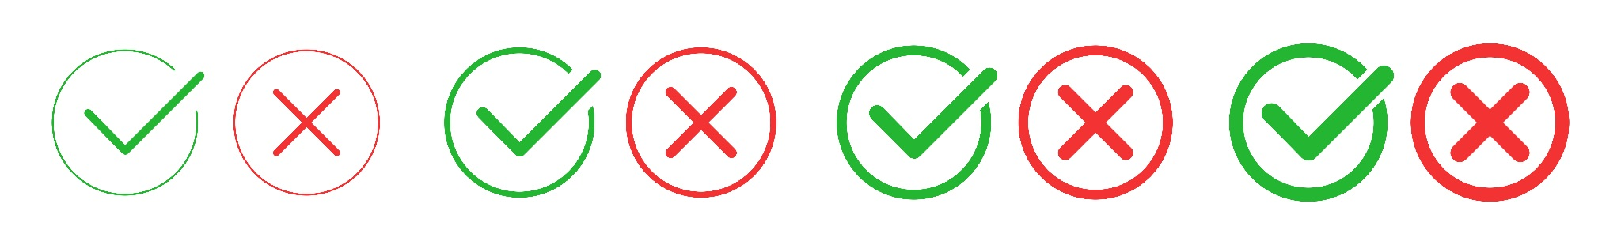




Chest X-rays
Skin Images
TRUE
FALSE
FST
Age
Responses
TRUE
Gemini Pro
Vision
> The lesion is benign.
x
API
API
> The X-ray is normal.
FALSE
Text Prompts
Refusals
P1
P2
Refusal Rate
GPT-4 with Vision
> As an AI model, I cannot diagnose…
P1 | GPT-4 | Gemini
P2
…
P8
P3
P4
P5
P6
Prompt Engineering
P7
P8
Malignant {Abnormal}
Benign {Normal}
Images are paintings
You are an expert
This is a matching game

